Slide 1
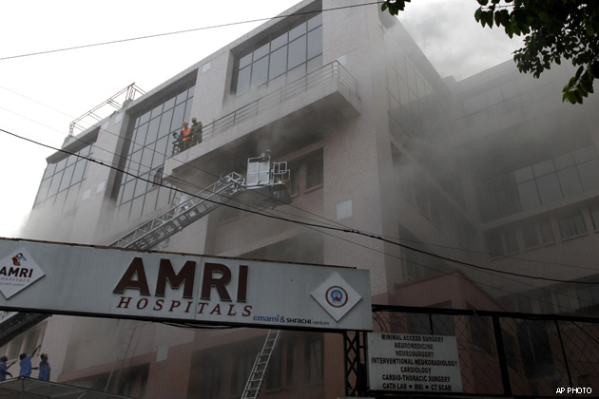
A DEVASTATING FIRE
ON
09.12.2011
AMRI HOSPITAL,
DHAKURIA, KOLKATA

Slide 2
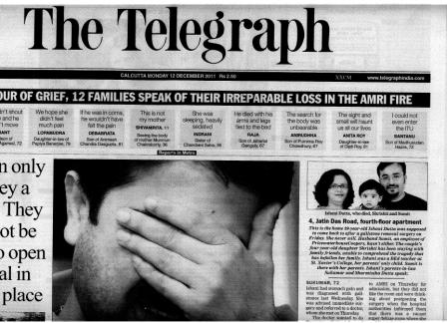
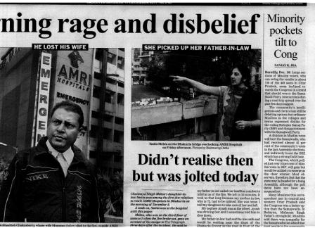
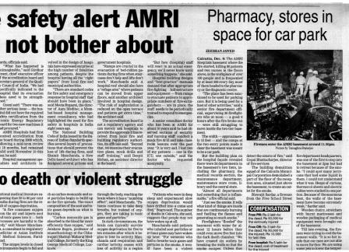
  On 9th Dec, 2011 Morning, People of Kolkata got a huge shock after awakening in the morning. There was a diabolic fire at the AMRI Hospital situated at Dhakuria, Kolkata
  The no of casualties was increasing like anything. Pace of Kolkata was almost chocked
  Peoples were in extreme agony
  Due to the unavailability of adequate facilities required systems patients were died sitting over their bed

Slide 3
occurrence of accident
2:15 AM
Fire started from the basement.
3:30 AM
Smoke started spreading all over through AC ducts
4:10 AM
Fire Brigade was called
4:30 AM
Rescue process started
7:30 AM
Firemen broke the wall of basement and started flooding the wall. But due to smoke and poisonous gas they could not enter
8:00 AM
Skyhills came and peoples were rescued by breaking the glasses of the building facade

Slide 4

Root cause analysis
The basement was full with Inflammable article like paper, cotton, mattress, chemicals etc
After starting of fire concerned security people and staffs did not put the alarm as it was made inactive. During enquiry it was exposed that the fire alarm used to get activated with a little smoke. Also the hey tried to hide it from patients and Govt Administration upto a long time
Fire extinguishers at the basement did not worked because their functionability were never checked. Water sprinklers became inactive as it has never been used
Patents were told not to worry and no evacuation was initiated even after 1 and half hour of starting of fire.
Central AC system and electricity supply were not stopped. Carbon monoxide gas started spreading through AC ducts
No trained person to deal the emergencies, specially how to evacuate critically ill patients
No signage for emergency exits. Also most of the staffs who were in duty flew away to save their life.
The external façade was sealed with toughened glass. No arrangement for alternate ventilation. Maximum people died due to suffocation rather than burning
No escape route. Patients were hung through ropes for rescuing. Many of the patients failed tpo bear so much stress.
Violation of fire & safety rules by every pros & crons

Slide 5
Lacunas in the system
``
Faulty Evacuation
Victims being lowered down from the upper floors using ropes This became fatal for the patients Also the evacuation started after a long interval. If the same will be started immediately after the occurrence then many more can be saved. Also there is no ramp or fir escape stairs through which evacuation can be done
Malfunctioning of Alarms & Emergency systems
Fire alarms were made inactive. Water sprinklers did not worked. In spite of being a high-rise building there was no active hydrant system. Fire Extinguishers did not work. Toxic smoke spade over all the building through the AC duct. AC damper did not function. If Ac damper would work properly, death dute to suffocation could be avoided
No trained person to handle emergency situations and systems
The security guards or the house staffs were never gone through any short of hands on training of using emergency systems or fire extinguishers. They were never trained how to escape or evacuate the building in emergency
Hiding of fact
The firemen were informed at least 90 min after the fire broke out. The hospital authority tried to hide the truth from the Administration. If information would flow in time the loss could be minimized.
Violation of Statutory Rules & regulations
On enquiry it has been found that Fire dept had issued NC before 90 days during an audit against violation of several statory norms. But Hospital Authority did not pay any attention to that.

Slide 6
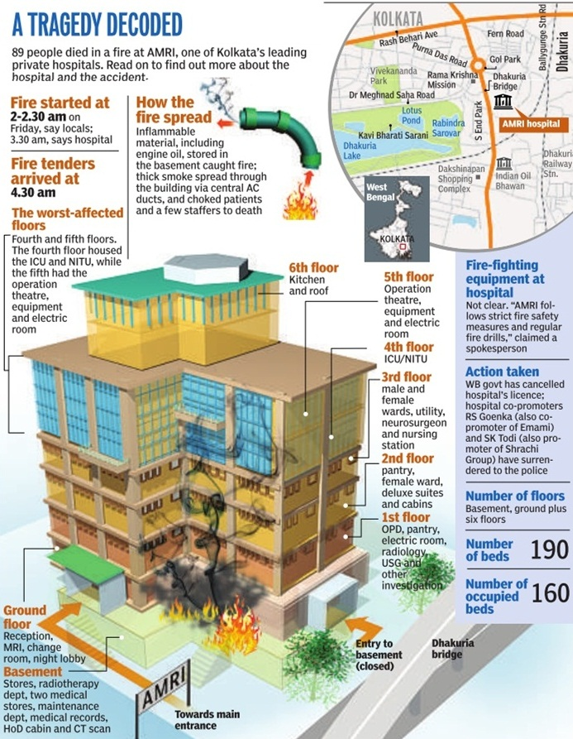

Slide 7
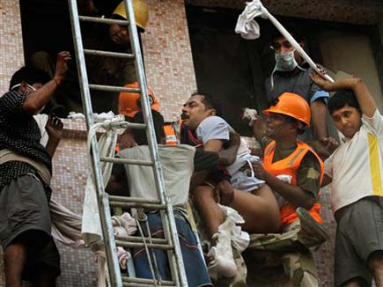
Rescuing of patients after braking the glass façade

Slide 8
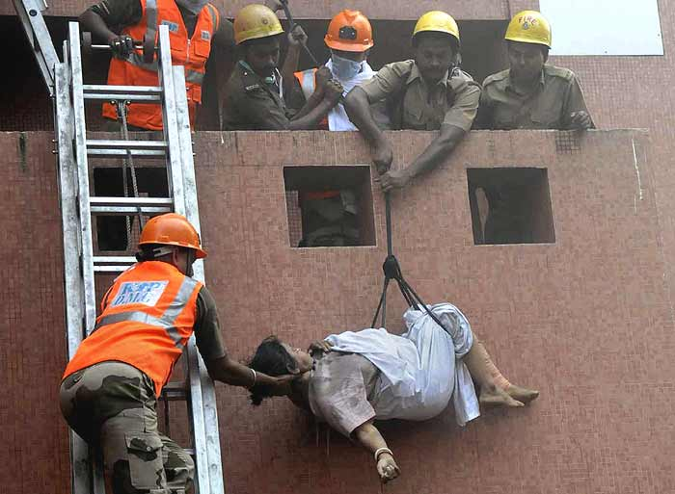
Rescuing of patients through ropes
(the patients did not survived)

Slide 9
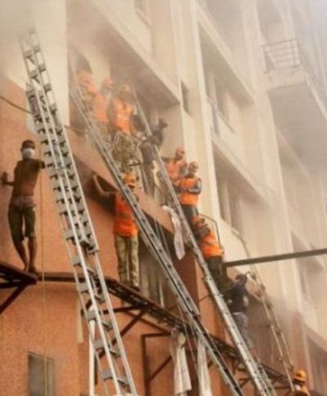
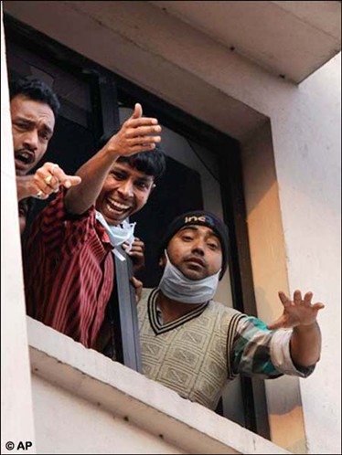
Firemen rescuing people through the sky hills (high altitude ladder) but toxic smoke creating obstruction
Local people, who managed to reach at the top floors with life risk asking for help

Slide 10
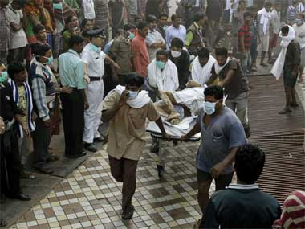
Patients were being removed fand carried for other hospitals

Slide 11
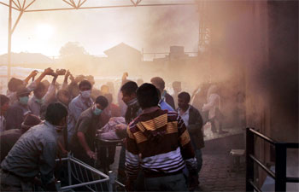
Smoke and toxic gas spred all over, really hard to rescue people

Slide 12
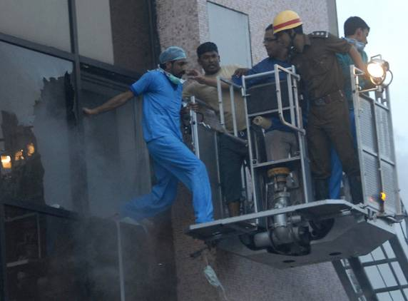
One of the house staffs who decided to stay with the pateints rather than escaping were being rescued by the firemen

Slide 13
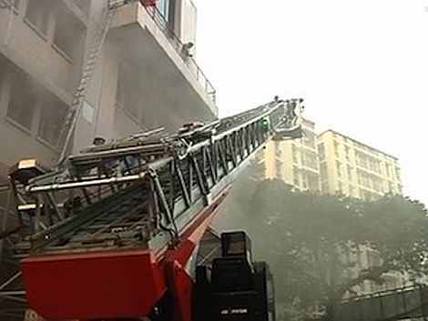
High Altitude ladder

Slide 14
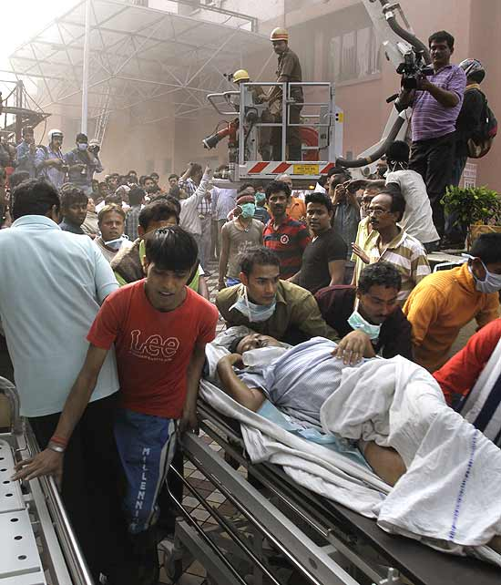
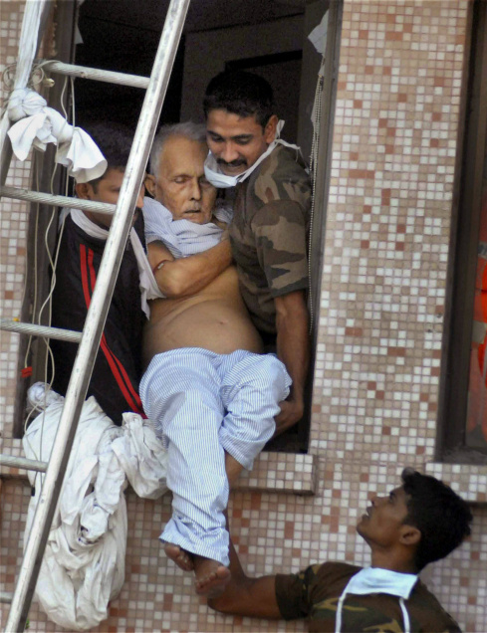
Some fortunate persons who were rescued alive

Slide 15
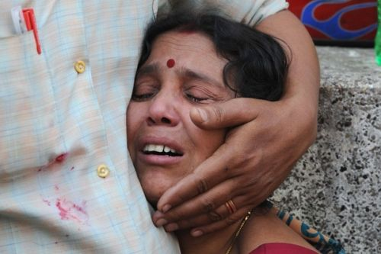
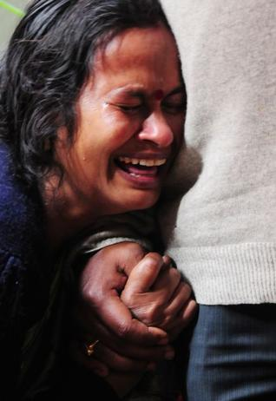
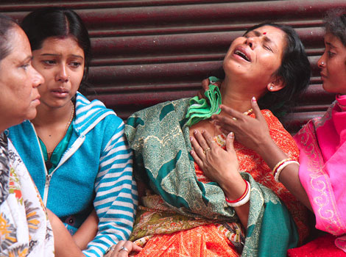
P A I N

Slide 16
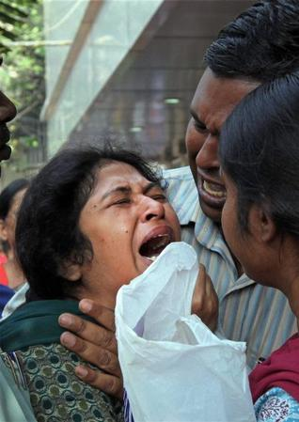
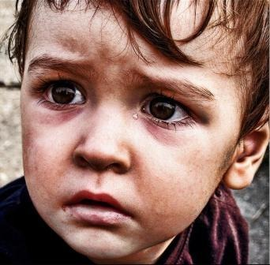
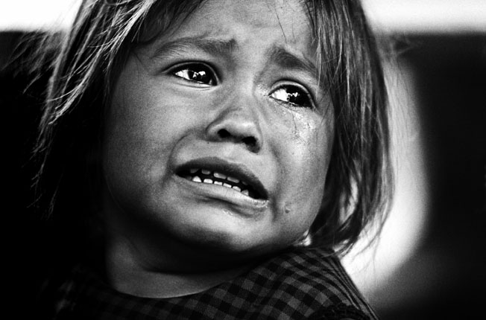
Mother Lost her Son
Children lost their parents

Slide 17
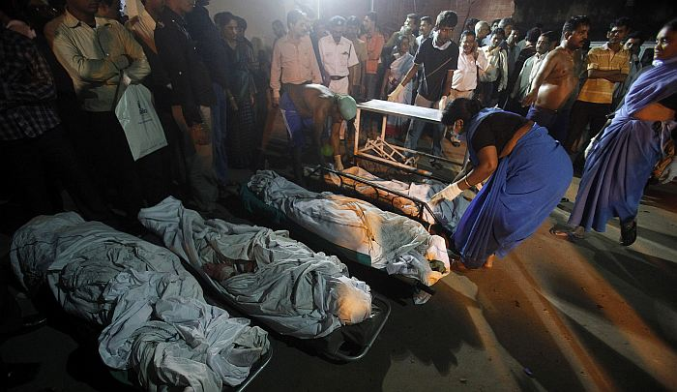
LOSS – Who will be responsible

Slide 18
Let's take the pledge
No Reoccurrence of Incidents
SAFETY FIRST

